Slide 1
Seminar: Deep Learning for Molecular Biology
Alice McHardy, Giorgos Kallergis, Mohammad Hadi Foroughmand Araabi
Helmholtz Center for Infection Research & TU Braunschweig
23.10.2025

Slide 2
Seminar overview
Max. number of participants: 10
Language: English
Requirements:
Student pairs must give both practical (implementation in Python) and theoretical presentations (split topics).
At least one meeting with the assistants.
7-10 page summary of the topic, with scientific report template, for example with literature references (to be sent together with the code, two weeks before seminar date)
Each student should write 3.5-5 pages of the report.
It should contain scientific literature, acknowledgement of the used tools (which and how, e.g. ChatGPT), you should take full ownership of the report, it means understand and approve every sentence there and know every reference you cite.
One presentation of 30 minutes with approx. 15 minutes of presentation per person, plus 10 discussion
Final grade= 50% presentation, 50% report
Designated for Bachelor and Master students of Computer Science.

Slide 3
Course Takeaways
Basic Knowledge of Machine Learning: Understanding of fundamental concepts in machine learning.
Machine Learning:
A hot topic in both scientific research and industry applications.
Wide-ranging impact across various domains, from healthcare to finance.
Basic Knowledge of Deep Learning: Familiarity with the principles of deep learning.
Deep Learning:
Specialized models built upon neural network architectures.
Remarkable success in tackling complex and challenging problems across domains.
Basic Knowledge of Bioinformatics
Understanding of bioinformatics principles and applications.
Awareness of how machine learning and deep learning are applied in bioinformatics research.
Experience in Problem Solving:
Practical experience in applying machine learning and deep learning techniques to bioinformatics problems.

Slide 4
Introduction to Bioinformatics, Machine Learning, and Deep Learning

Slide 5
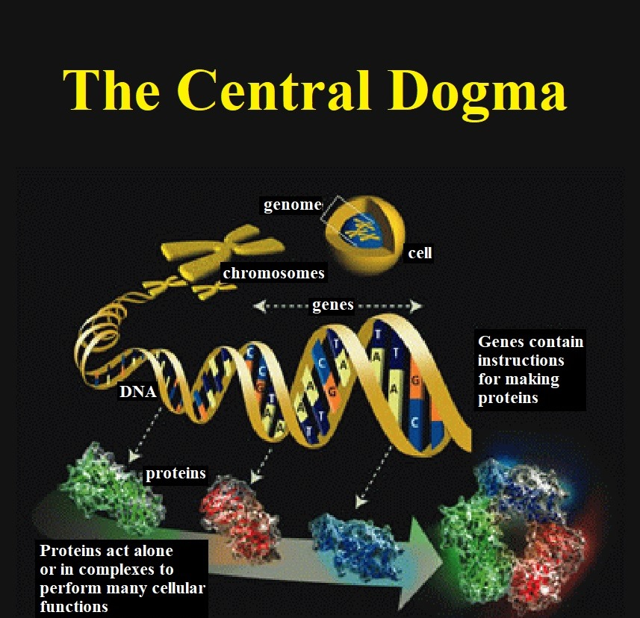
What is bioinformatics
(Current) Biology =
DNA + RNA + Protein + Interactions
Bioinformatics: Computational analysis of the biological data

Slide 6
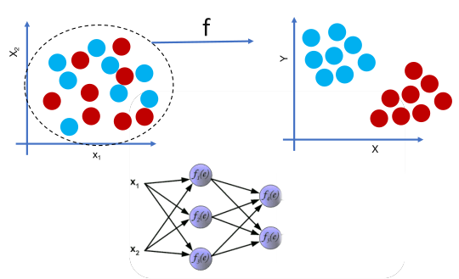
Machine Learning & Representation learning
Machine Learning is a subset of artificial intelligence focused on developing algorithms that enable systems to learn patterns, representations, or behaviors from empirical data
Constructs models that generalize from training data to unseen instances by optimizing a loss function
Includes supervised, unsupervised, and reinforcement learning, with applications in classification, regression, clustering, and decision-making.
Representation learning:
Data can be represented as points in n-dimensional space (of features)
Learns hierarchical or latent representations that capture underlying structures in data
Then, we can solve several problems, e.g. classification.

Slide 7
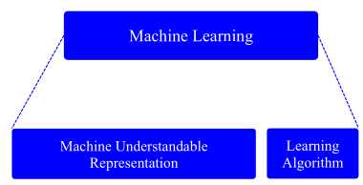
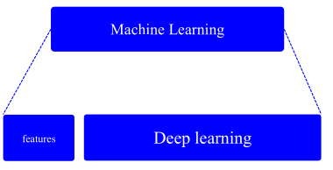
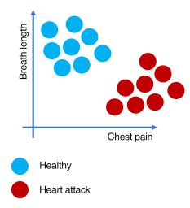
What is machine learning
We alter data appearance to be interpretable by the audience.
Machine as the audience? Numerical values, vectors, matrices
Finding a proper representation has been critical in machine learning
Domain knowledge
for designing representation

Slide 8
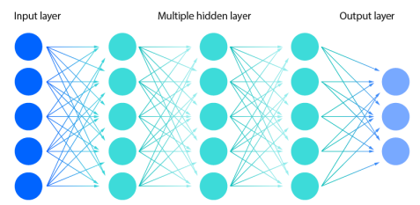
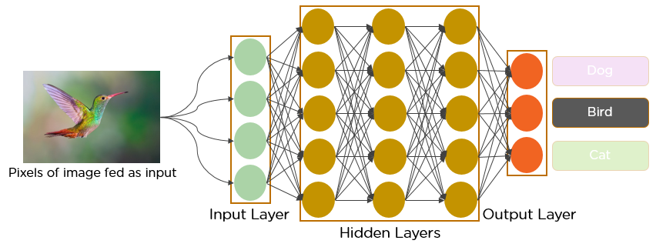
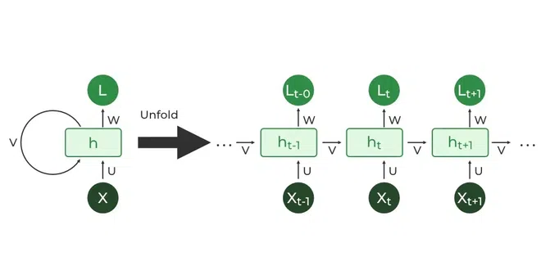
Specific ML models: NN, RNN, CNN
Neural network (NN): Inspired by brain
Convolutional Neural Network (CNN): NN with fewer (redundant) parameters
Recurrent Neural Network (RNN): Dealing with sequential information
Source: https://www.ibm.com/topics/neural-networks, https://www.geeksforgeeks.org/introduction-to-recurrent-neural-network/, https://www.analyticsvidhya.com/blog/2021/05/convolutional-neural-networks-cnn/

Slide 9
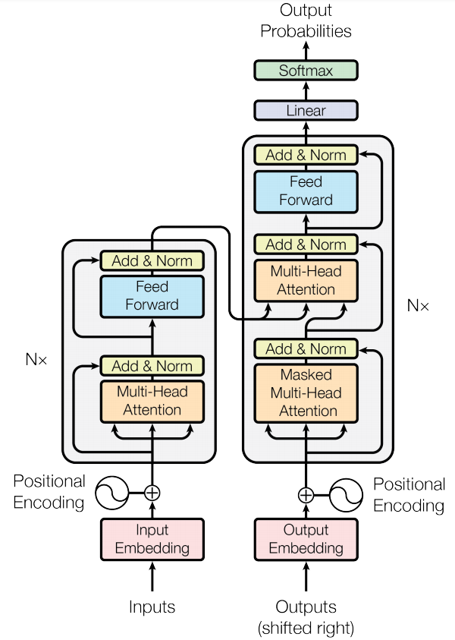
What is a transformer?
A specific architecture with breakthrough performances
Encoder/Decoder architecture
Used in a wide range of applications
Effective
Highly parallelizable
Ideal for transfer learning
Transformers model architecture.
Vaswani et al, Attention is all you need. (NIPS 2017)
Seite ‹#› |

Slide 10
Applications of deep learning
Computer Vision
Natural Language Processing
Bioinformatics
Advertising
…

Slide 11
Your task
Find a partner to form a group
Choose a topic (from provided list)
Study the topic
Some literature is provided
Meet and consult with the lecturers (at least once)
Implement and test your topic with the dataset (if applicable)
Evaluate (Metrics, precision/recall, TP, TN, …)
Create a written report
Using AI tools is permitted; please detail their use in the acknowledgements section!
Present your topic on the presentation day

Slide 12
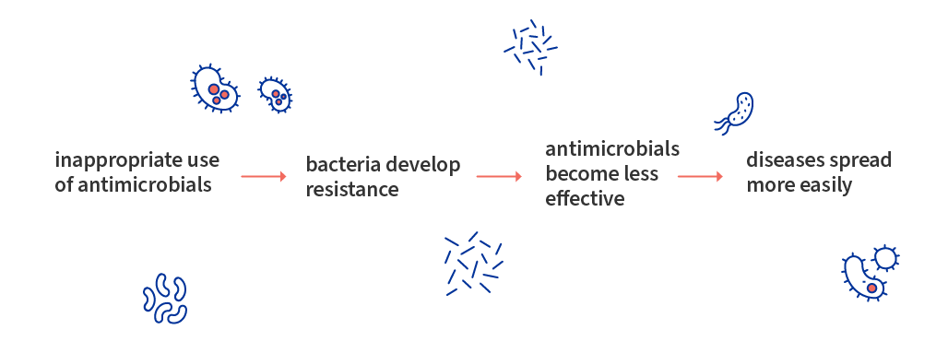
Implementation Tasks
Antimicrobial Resistance of pathogens (AMR)
“AMR occurs when bacteria, viruses, fungi and parasites change over time and no longer respond to medicines making infections harder to treat and increasing the risk of disease spread, severe illness and death.” WHO

Slide 13
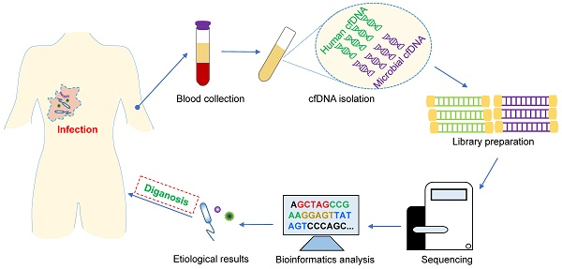
Implementation Tasks
Antimicrobial Resistance of pathogens (AMR)
“AMR occurs when bacteria, viruses, fungi and parasites change over time and no longer respond to medicines making infections harder to treat and increasing the risk of disease spread, severe illness and death.” WHO
LAB PART
Your Task
TASK: For each antibiotics, is this pathogen resistant to these antibiotics?
Genomic sequence:
ATTCGGATTGC….
Source: https://www.thno.org/v10p5501.htm

Slide 14
Datasets description
Git repository: https://github.com/hzi-bifo/seminar-dlmb-2025-winter-public
Staphylococcus aureus - cefoxitin pbp4 dataset
Predict AMR for a pathogen (Staphylococcus aureus) against an antibiotic (Cefoxitin) given the genomic sequence of one of its genes (gene pbp4) as input
899 genomes
Training set (800 samples) and test set (99 samples)
Labels: 0 (non-resistant), 1 (resistant)
This dataset is the mandatory dataset, the two others are extra and optional datasets.

Slide 15
Datasets description (Extra)
Git repository: https://github.com/hzi-bifo/seminar-dlmb-2025-winter-public
Staphylococcus aureus - cefoxitin dataset
Predict AMR for a pathogen (Staphylococcus aureus) against an antibiotic (Cefoxitin) given the genomic sequence of all its contigs as input
Note that each pathogen’s genome is given as a set of contigs
954 genomes
Training set (847 samples) and test set (107 samples)
Labels: 0 (non-resistant), 1 (resistant)

Slide 16
Datasets description (Extra)
Git repository: https://github.com/hzi-bifo/seminar-dlmb-2025-winter-public
Klebsiella pneumoniae - aztreonam dataset
Predict AMR for a pathogen (Klebsiella pneumoniae) against an antibiotic (Aztreonam) given the genomic sequence of all its contigs as input
Note that each pathogen’s genome is given as a set of contigs
1178 instances
Training set (1135 samples) and test set (143 samples)
Labels: 0 (non-resistant), 1 (resistant)

Slide 17
Topics

Slide 18
Topics
Feed-forward Neural Networks and back propagation [2 students]
Convolutional Neural Networks (CNNs) [2 students]
Recurrent Neural Networks and LSTMs [2 students]
Transformers - Encoders [2 students]
Transformers - Decoders, Encoder-Decoders [2 students]

Slide 19
Feed-forward Neural Networks and back propagation [2 students]
Goals: Getting familiar with the basics of neural networks
Introduction to linear classification, multilayer perceptron (MLP), and back propagation algorithm
Implementation in python using MLP
Suggested references
Linear prediction: Lec. 1,2 at (https://bit.ly/1DIpc51) and (Chapter 4: https://stanford.io/2voWjra)
G. Hinton’s lecture 2, 3: https://bit.ly/3TNBPqw
Lecture from U of Waterloo: https://bit.ly/2A2mzgN
Stanford Tutorial: https://stanford.io/1FRrkZw
Practicals: In Keras (keras.io) or Pytorch (pytorch.org)

Slide 20
Convolutional Neural Networks (CNN) [2 students]
Goals: Getting familiar with the convolutional neural network
CNN
Implementation in python using only CNN
Suggested references
MIT notes: https://tinyurl.com/3c8fk4mz
G. Hinton’s lecture: https://bit.ly/3TNBP qw
Stanford Tutorial: https://stanford.io/1FRrkZw
A more advanced reference: deeplearningbook.org
Practicals: In Keras (keras.io) or Pytorch (pytorch.org), e.g. https://tinyurl.com/yfy56ay5

Slide 21
Recurrent Neural Networks [2 students]
Goals: Getting familiar with the RNNs and in particular LSTM
Understanding “Vanilla” RNN
Understanding the LSTM architecture (in particular read: https://bit.ly/1S6gmjZ)
Implementation in python using only RNNs and LSTM
Suggested references
Lecture from U of Waterloo: https://bit.ly/2RCNEhn
Understanding LSTMs: https://bit.ly/1S6gmjZ
MIT notes: https://tinyurl.com/2x4z77fz
G. Hinton’s lecture: https://bit.ly/3TNBPqw
A more advanced reference: deeplearningbook.org
Practicals: In Keras (keras.io) or Pytorch (pytorch.org)

Slide 22
Transformers - Encoders only models [2 students]
Goals: Getting familiar with the concept of transformers architecture
Encoder part of a transformer model (e.g., Bert)
Implementation in python using encoders-based transformers models
You are allowed to use a pretrained model
Suggested references
Representation learning: https://arxiv.org/pdf/1206.5538.pdf
Transformer paper: https://arxiv.org/abs/1706.03762
Simple explanation of transformers: https://jalammar.github.io/illustrated-transformer/
Simple explanation of the details: https://serrano.academy/
Practicals: In Keras (keras.io) or Pytorch (pytorch.org)
Practicals: https://huggingface.co/docs/transformers/notebooks

Slide 23
Transformers - Decoder-only and Encoder - Decoders [2 students]
Goals: Getting familiar with the concept of these architectures
Decoder-only models (GPT)
Encoder-decoder models
Their applications in bioinformatics
Suggested references
Representation learning: https://arxiv.org/pdf/1206.5538.pdf
Transformer paper: https://arxiv.org/abs/1706.03762
Simple explanation of transformers: https://jalammar.github.io/illustrated-transformer/
Simple explanation of the details: https://serrano.academy/
Practicals: In Keras (keras.io) or Pytorch (pytorch.org)
Practicals: https://huggingface.co/docs/transformers/notebooks

Slide 24
Further steps
Send an email (to both of us)
From one member CC all other members
Send three preferred topics in the order of preference
Until October 30th
If you have problem forming a team, send us an email!
Split pairs: theoretical vs. practical tasks
Meeting and consultation with the lecturers (at least once) Let us know in case of conflicts within the team
Send report two weeks before the seminar day
Final seminar date:
TBD 9:00 - 13:00 at BRICS (22nd or 29th of January).
Any questions? Contact us:
mohammad-hadi.foroughmand-araabi@helmholtz-hzi.de
georgios.kallergis@helmholtz-hzi.de

Slide 25
The End

Slide 26
References
Deep learning in Life Science Youtube series
AMR image https://www.consilium.europa.eu/en/infographics/antimicrobial-resistance/

